Slide 1
Prediction of Housing Prices in King County, Washington
Ronny Malkowski, Nicholas Nikolov, Alexandria Pokorny

Slide 2

Goal
Initial Goal was to predict housing prices accurately with the highest attainable accuracy which we defined to be the model with the lowest root mean squared error (RMSE) and lowest average deviation.

Slide 3

Why Predicting Prices Matter
Benefits Consumers
Gives consumers insights into how much they can sell for
Benefits Appraisers
Comprehensive model gives appraisers a consistent method for valuing homes

Slide 4
Housing Price Explanatory Variables
Price is predicted by
Number of bedrooms
Number of bathrooms
Number of floors
Square footage of living area
Square footage of lot
Waterfront Property
View
Square footage of house in 2015
Condition
Grade
Square footage above ground
Square footage of basement
Year built
Year renovated
Zip code
Square footage of lot in 2015

Slide 5
Pre-Processing and Initial Feature Selection
Elimination of variables such as ID, Date, and Latitude/Longitude
Elimination of singularity
Sqft_living = sqft_above + sqft_basement
Factorization of Zip Code
Training/Test split

Slide 6
Ordinary Least Squares Process Outline
Data visualization/Initial adequacy checking
Multicollinearity and Variance Inflation
Outlier Alleviation
Subset Selection
Variable Transformation
Final Model

Slide 7
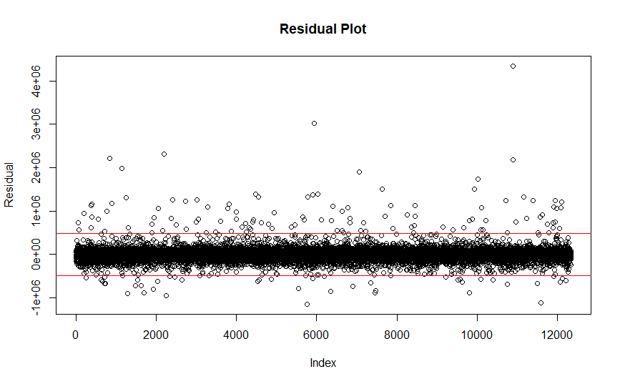
Data Visualization/Initial Adequacy Check
Positive skew in response
Mean: $540,088.10
Median: $450,000
Many high outliers
Almost $8 million homes

Slide 8
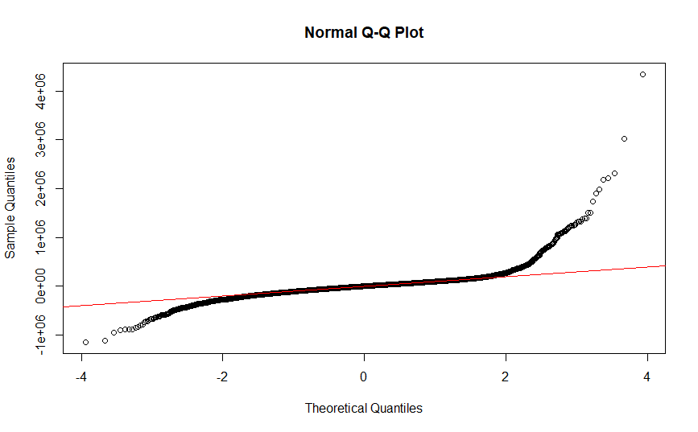
Data Visualization/Initial Adequacy Check
Positive skew in response
Mean: $540,088.10
Median: $450,000
Many high outliers
Almost $8 million homes

Slide 9
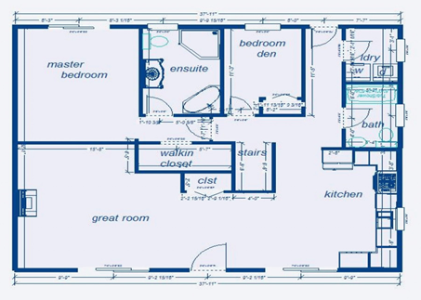
Multicollinearity and Variance Inflation
Some noticeable simple correlation between regressors
Square footage variables were collinear
Simple correlation between grade and square foot of house was highest (0.7559)

Slide 10
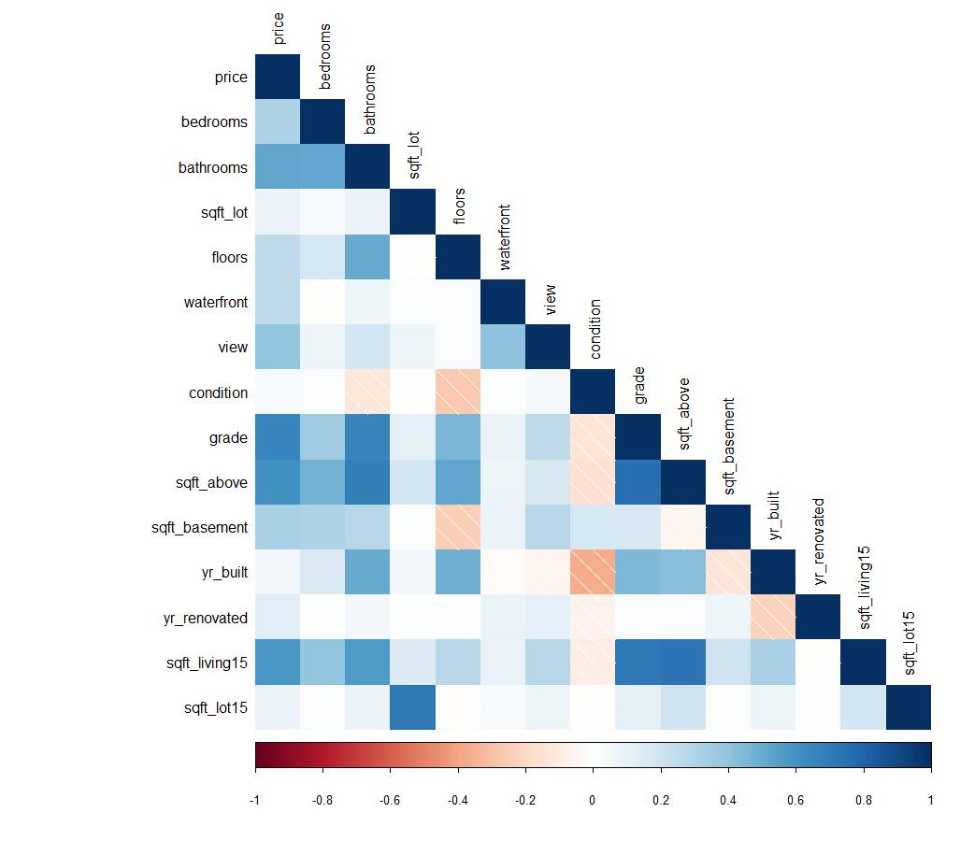
Multicollinearity and Variance Inflation

Slide 11
Multicollinearity and Variance Inflation
Variance inflation was present but controlled
Highest inflation came from sqft_above with a factor of 5.218.
All other factors were less than 4.

Slide 12
Outlier Alleviation
Utilize median to measure center of data
Trim outliers at 4 standard deviations from median
Performance Measure | Before Trim | After Trim
RMSE | 151,035.4 | 143,030.6
Mean Absolute Deviation | $97,386.32 | $90,954.82
Median Absolute Deviation | $68,650.84 | $64,129.50

Slide 13
Subset Selection
Backward Elimination
Reduced number of variables from 84 to 68
Removed some zip code dummy variables
Removed sqft_lot15 (lot size in 2015)
Forward Selection
Automatic algorithm pushed all variables into model

Slide 14
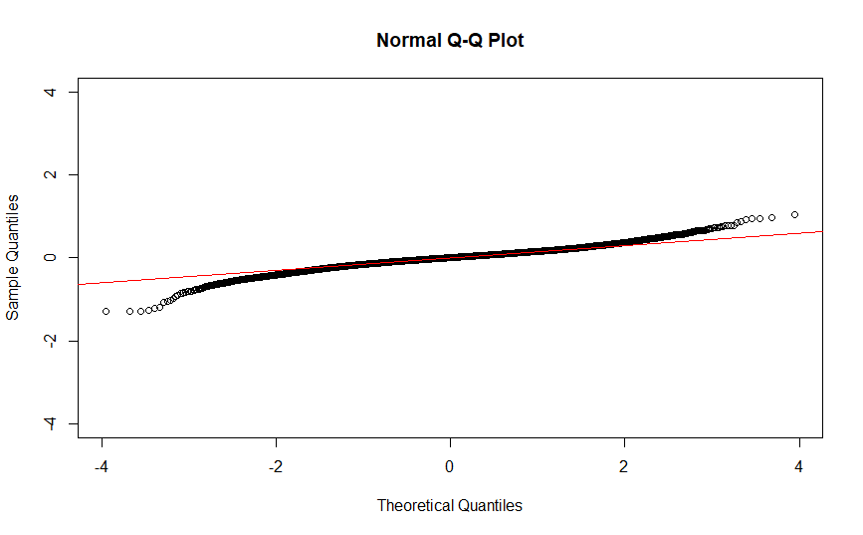
Log Transformation
Look at predicting log(Price) instead
Adjusted R-Square in this model is .8774
RMSE improved
Mean absolute deviation improved
Median absolute deviation improved

Slide 15
Log Transformation
Performance Measure | Before Transform | After Transform
RMSE | 143,030.6 | 122,718
Mean Absolute Deviation | $90,954.82 | $71,695.63
Median Absolute Deviation | $64,129.50 | $44,084.43

Slide 16
Artificial Neural Network Process Outline
Initial Model Fit
Best Architecture Search
Final Model Discussion
Activation Function
Loss Function
Epochs

Slide 17
Initial Model Fit
Feedforward neural network learning with stochastic gradient descent with backpropagation
One layer, 100 neurons, Rectifier activation function, Absolute loss function
Performance Measure | Best Regression | Initial ANN
RMSE | 122,718 | 118,360
Mean Absolute Deviation | $71,695.63 | $69,377.81
Median Absolute Deviation | $44,084.43 | $42,760.74
Notes:
Goal of backprop is to take partial derivs of Cost fctn with respect to weights and w.r.t biases

Slide 18
Best Architecture Search
Observing best achievable performance for one and two layer networks.
Evaluated by median prediction deviation from true price.
Best model was two layer with 25 and 19 neurons respectively
Median deviation of $40,640.03

Slide 19
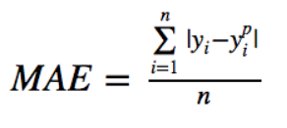
Final Model
Two hidden layers with 25 and 19 neurons respectively.
Rectifier Activation Function
f(x) = max(0,x)
Mean Absolute Error Loss Function
300 epochs
Performance Measure | Best Regression | Best ANN
RMSE | 122,718 | 118,745.3
Mean Absolute Deviation | $71,695.63 | $69,588.98
Median Absolute Deviation | $44,084.43 | $41,345.82

Slide 20
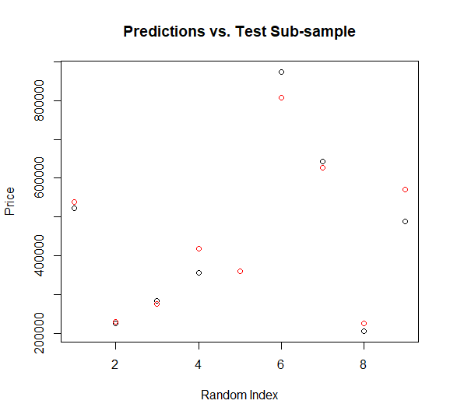
Conclusion
Proper handling of regression models can lead to strong predictive accuracy
ANN has greater predictive accuracy and potential than regression model
Overall, both methods led to excellent accuracy for a majority of homes
$675.61 prediction error for index 5
$83,598.70 prediction error for index 9

Slide 21
Bibliography
Morano, P., Tajani, F., & Torre, C. M. (n.d.). Artificial intelligence in property valuations An application of artificial neural networks to housing appraisal, 7.
Newsome, B. A., & Zietz, J. (1992). Adjusting Comparable Sales Using Multiple Regression Analysis - The Need for Segmentation. The Appraisal Journal; Chicago, 60(1), 129.
Nguyen, N., & Cripps, A. (2001) Predicting Housing Value: A Comparison of Multiple Regression Analysis and Artificial Neural Networks, Journal of Real Estate Research, Vol. 2
Rodrigez, M. & Simans, C.F. (1994) Quantifying the Value of Single Family Housing Markets, The Appraisal Journal.
Sirmans, G. S., MacDonald, L., Macpherson, D. A., & Zietz, E. N. (2006). The Value of Housing Characteristics: A Meta Analysis. The Journal of Real Estate Finance and Economics, 33(3), 215–240. https://doi.org/10.1007/s11146-006-9983-5

